Slide 1
Tag Helpers (HTML generators)
Introduction to Tag Helpers – ASP.NET Core Documentation
David Turton
Conestoga College
Institute of Technology and Advanced Learning
dturton@conestogac.on.ca
Doon 2A605 x3610

Slide 2
HTML Helpers vs Tag Helpers
HTML Helpers were introduced in MVC 3, with Razor (2010)
Generate HTML elements for hyperlinks, data input and display
Inputs are adapted to suit the datatype & data format of each target field
Still used to display the value of a field, formatted as per the model
Also to show the display name of fields in a collection of model objects
Most everything else has been replaced by Tag Helpers
asp- attributes added to HTML5 elements
Will generate HTML attributes pertinent to the model field:
<input type="text" … or "numeric" or "email" or "date" …
Adds data- validation: required, numeric, date, regular expression, range, etc.

Slide 3
<form method="get" action="/Album/Search" >
<form> is a container for input elements
Submit button in form sends all input controls in the form to controller
As name/value pairs
Action
Where to send the information … who's expected to act on it
In MVC: receiving controller & action
… could be to another site, could specify ID & QueryString parameters
If missing, it uses the current page's URL
Method
How to send values of input fields between <form> & </form>
Get → name/value pairs in the QueryString after URL
Post → name/values pairs inside the HTTP request
General rule: Get for reads, Post for writes

Slide 4
Small Form Examples
This passes the variable "q" to the "Search" action in the "Album" controller (relative to the current server):
This passes the variables "q" & "country" to the Bing search engine:
<form action="/Album/Search" method="get">
<input type="text" name ="q" />
<input type="submit" value="Search" />
</form>
<form action="http://www.bing.com/search" method="get">
<input name="q" type="text" />
<input name="country" type="text" />
<input type="submit" value ="Search!" />
</form>

Slide 5
Small Form Examples – Tag Helper version
This passes the variable "q" to the "Search" action in the "Album" controller:
This passes the variable "q" to the Bing search engine:
<form asp-controller="Album" asp-action="Search" method="post">
<input type="text" name="query" />
<input type="submit" name="Search" value="Search" />
</form>
<form action="http://www.bing.com/search" method="get">
<input name="q" type="text" />
<input name="country" type="text" />
<input type="submit" value ="Search!" />
</form>

Slide 6
<form> Tag Helpers specifying the target controller & action
The default action, if not specified in the <form>tag
Uses the current URL, less the ID portion and QueryStrings
asp-controller="Album"
This replaces the controller in the current URL
asp-action="search"
This replaces the action in the current URL
Example (the resulting URL retains the original http://server/)
<form asp-controller="album" asp-action="search" method="get">
Produces:
<form method="get" action="/Album/search">

Slide 7
<form> Tag Helpers method="post" adds security
<form asp-controller="album" asp-action="search" method="post">
Produces:
<form method="post" action="/album/search">
<!-- input and submit elements -->
<input name="__RequestVerificationToken" type="hidden" value="CfD34…" />
</form>
The RequestVerficationToken prevents cross-site request forgery
pronounced "c-surf"
…someone intercepting the request cannot replay it nor alter it
(if the receiving action has [ValidateAntiForgeryToken] annotation to look for it)
Plus

Slide 8
method="get" …vs… method="post"
"Get" tacks all input fields on the form onto the URL
As QueryString variables
These are visible to the user and nasties looking over their shoulder
User can save & replay the request later
Nasties can intercept & replay request … with altered values
"Post" puts the input fields into the request body
Variables are not visible to the user (or to nasties)
Cannot be saved, cannot be replayed … on some browsers
Anti-forgery token added
Prevents nasties from intercepting, altering & replaying request
General rule: get for reading, post for everything else
Better rule: post for everything, get when justified & then only for reading
Best Rule: post and HTTPS for everything.

Slide 9
POST example: post-back Create
<h2>Create</h2>
<form asp-action="Create">
<div class="form-horizontal">
<h4>Album</h4>
<hr />
No method specified … so it defaults to POST
No controller specified … defaults to current (Album)
- anti-forgery token generated in View & validated in action
// post-back Create action
// save new Album record to the database, if it passes the edits.
[HttpPost]
[ValidateAntiForgeryToken]
public async Task<IActionResult> Create([Bind("AlbumId,AlbumArtUrl,ArtistId,GenreId,Price,Title")] Album album)
{

Slide 10
<form> Tag Helpers Passing variables in/on the URL
<form asp-controller="album" asp-action="search"
asp-route-id="5" asp-route-genre="jazz" method="post">
asp-route-variableName
If variableName is "id", it'll be added to the URL as the 3rd segment
Otherwise, VariableName will become a QueryString variable
→ These will be retained on the URL even with method="POST"
Result:
<form method="post" action="/album/search/5?genre=jazz">

Slide 11
<form> Tag Helpers less common <form> tags
asp-route="fred"
Interpret the URL using the RouteMap called "fred" in Startup.cs
asp-route-returnURL="@ViewData["returnURL"]
This is really just a QueryString variable called "returnURL"
It's a mechanism user/role security uses when calling /Account/Login
If the user requests a page they're not authorized to see
They'll be sent to the logon page with a QueryString variable named returnURL
If they sign on correctly, they'll be redirected to the requested URL

Slide 12
Aside: submit button's formaction override
The submit button can override the <form> action attribute:
<input type="submit" value="Displayed Text" formaction="/controller/action?albumId=5"/>
Use this when:
You have two different actions possible
So you want two submit buttons
You don't want the default URL that got you to this page
Courtesy of: William Mitchell, fall 2015

Slide 13
Create a Search action in AlbumController - find albums with a given string in the title or artist name
// action to show all albums with given string in title or artist name
public ActionResult Search(string query)
{
var albums = _context.Album.Include(a => a.Artist)
.Where(a => a.Title.Contains(query) || a.Artist.Name.Contains(query));
return View(albums);
}
Remember: Entity Framework is built on LINQ (Language Integrated Query) … this is why it's using C# syntax
EF statements would look different if the project was built on Visual Basic .NET

Slide 14
HTML Form to do the search
Put this in the banner area of _Layout.cshtml
<form asp-controller="Album" asp-action="Search" method="get">
<input type="text" name="query" />
<input type="submit" name="Search" value="Search" />
</form>
Every page now has an album search facility
It doesn't matter to the program if you use "get" or "post"
Binder will find the first field named "query"
With "get", the user can store the search request

Slide 15
Create view for Search action
@model IEnumerable<MvcMusicStoreCore.Models.Album>
@{ViewBag.Title = "Search Results";}
<h2>Search Results</h2>
<table>
<tr>
<th>Artist</th>
<th>Title</th>
<th>Price</th>
</tr>
@foreach (var item in Model)
{
<tr>
<td>@item.Artist.Name</td>
<td>@item.Title</td>
<td>@item.Price.ToString("c2")</td>
</tr>
}
</table>
It knows what model was passed in ViewData, so you can pick properties off each model item
and drill down to properties of imbedded objects

Slide 16
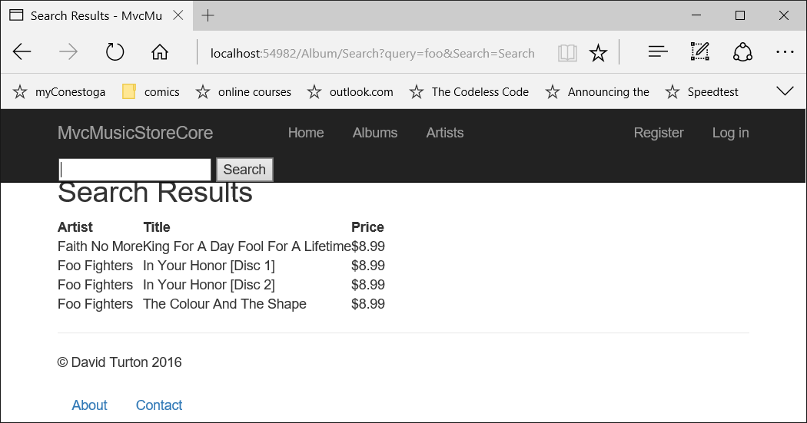
Result, using "get"

Slide 17
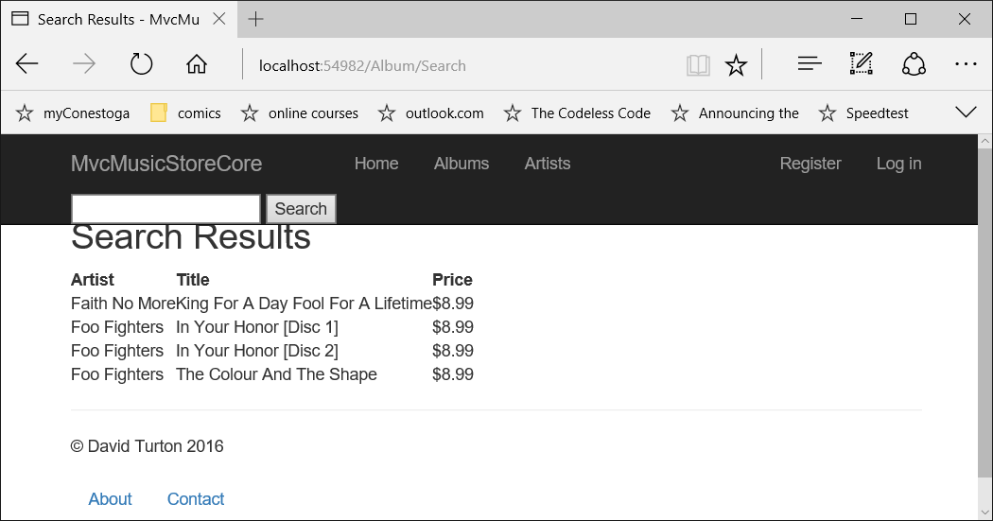
Result, using "post"

Slide 18
Setting up an Edit View
An exercise using Tag Helpers to create input controls

Slide 19
Post-back Controller action: MyEdit
[HttpPost]
[ValidateAntiForgeryToken]
public async Task<IActionResult> MyEdit(Album album)
{
if (album.Price < 0) ModelState.AddModelError("Price", "Price cannot be negative");
try
{
if (ModelState.IsValid)
{
_context.Update(album);
await _context.SaveChangesAsync();
TempData["message"] = $"album updated: {album.Title}";
return RedirectToAction("Index");
}
}
catch (Exception ex)
{
ModelState.AddModelError("", $"exception thrown on update: {ex.GetBaseException().Message}");
}
ViewBag.ArtistId = new SelectList(_context.Artist.OrderBy(a => a.Name), "ArtistId", "Name");
ViewBag.GenreId = new SelectList(_context.Genre.OrderBy(a => a.Name), "GenreId", "Name");
return View(album);
}
Creating a field edit error … in ModelState
"happy path" – no edit errors detected on Model
Intercepting any exception thrown by the database
"sad path" – set up variable for view, return Model, with errors, to View

Slide 20
Setting up a "MyEdit" View
"MyEdit" expects the record key to be passed
URL is something like "/Album/MyEdit/53
The form would start like this:
Declare that the model will be a single instance of the Album class
@model MvcMusicStoreCore.Models.Album
@{ ViewData["Title"] = "My Album Edit"; }
<h2>@ViewData["Title"]</h2>
<form asp-action="Edit">
<div asp-validation-summary="ModelOnly" class="text-danger"></div>
</form>
Override the title content in the layout's header
… and using the same variable for the page heading
Override the URL's action, leaving the current controller
Display any model-level errors here, red & bold
… change "ModelOnly" to "All" to include field-level errors

Slide 21
<div asp-validation-summary="ModelOnly" class="text-danger"></div>
After a record had been posted back but fails edits:
This will display the model errors in an unordered list, bold & red
"ModelOnly" – model errors, where key is ""
ModelState.AddModelError("",
$"exception thrown: {ex.GetBaseException().Message}");
"All" – list all model errors, both model- and field-level
ModelState.AddModelError("Price", $"Price cannot be negative");
Normally, field errors display beside the field
Sometimes, field errors don't show: spelled wrong, field hidden, etc.
… missing </span> …
That's why you should use "All" on exams…
Key (field-name) is empty for a model-wide error
Field-errors have a non-blank key.

Slide 22
Add labels & Inputs to Edit View
<form asp-action="MyEdit">
<div asp-validation-summary="ModelOnly" class="text-danger"></div>
<p>
<label asp-for="GenreId" class="col-md-2"></label>
<select asp-for="GenreId" asp-items="ViewBag.GenreId"></select>
<span asp-validation-for="GenreId" class="text-danger"></span>
</p>
<p>
<label asp-for="Title" class="col-md-2"></label>
<input asp-for="Title" />
<span asp-validation-for="Title" class="text-danger"></span>
</p>
<p>
<label asp-for="Price" class="col-md-2"></label>
<input asp-for="Price" />
<span asp-validation-for="Price" class="text-danger"></span>
</p>
</form>
GenreId dropdown
Title textbox
Price textbox, with numeric validation

Slide 23
Closing tag'd elements
Sometimes, there's no output from an element with tag helpers
Tag syntax is correct, etc.
See if you have a closing element, like </span>
Only naturally self-closed elements like <input … /> work without
Just add back the closing element and see.

Slide 24
<label asp-for="GenreId" class="col-md-2"></label>
Generates:
<label class="col-md-2" for="GenreId">GenreId</label>
You need </label> … otherwise you don't get any text displayed:
<label class="col-md-2" for="GenreId" />
asp-for="GenreId"
Uses field's display-name from model instead of techie field-name
for="GenreId" → this label refers to an input field with id="GenreId"
Clicking on the label selects the input field
class="col-md-2"
In bootstrap, each row is divided into 12 columns
This field takes the first two columns

Slide 25
<select asp-for="GenreId" asp-items="ViewBag.GenreId"> </select>
Generates a drop-down (<select>) named "GenreId"
<select data-val="true" data-val-required="The GenreId field is required."
id="GenreId" name="GenreId">
<option value="8">Alternative</option>
<option value="10">Blues</option>
…
<option value="1">Rock</option>
</select>
asp-for="GenreId"
Name of the drop-down & name of the variable it'll return to the controller
ID of drop-down … attribute to which the for="GenreId" in the label connects
Link to model field of same name
Will pre-select to the GenreId of the current model
asp-items="ViewBag.GenreId"
A SelectList or collection of SelectListItems containing all Genre records on file
Identifies the fields providing drop-down's selected value, the display text & the pre-selected value

Slide 26
Creating a SelectList for drop-downs and list-boxes
Album album = _context.Album.FirstOrDefault(a => a.AlbumId == id);
ViewBag.ArtistId = new SelectList(_context.Genre.OrderBy(a => a.Name), "GenreId", "Name", album.GenreId);
This specifies the collection
All records from Genre table
Identifies the property providing each <option>'s value
"GenreId"
Identifies the property providing each <option>'s displayed text
"Name"
And the initial selected value
"GenreId" from the selected album object
If not specified, Razor will push the GenreId from the model provided into the view

Slide 27
Alternate way … LINQ-like Entity Framework
ViewBag.genreId = _context.Genre.OrderBy(a => a.Name).AsEnumerable()
.Select(g => new SelectListItem
{
Text = g.Name,
Value = g.GenreId.ToString(),
Selected = album.GenreId == g.GenreId
});
This way, you can flag multiple items for a ListBox
ViewBag.genreId is cast differently in the View:
as IEnumerable<SelectListItem>
Same effect, but interesting to see:
Only the Name & GenreId are included
Each item has its own "Selected" Boolean
So multiple items on a ListBox can be pre-selected

Slide 28
<span asp-validation-for="GenreId" class="text-danger"> </span> ← remember this!!!!
Generates:
<span class="text-danger field-validation-valid"
data-valmsg-for="GenreId" data-valmsg-replace="true"></span>
data-valmsg-for="GenreId"
This will be loaded with any ModelState error having the key "GenreId"
data-valmsg-replace="true"
Allows client-side validation messages to replace contents of <span> container

Slide 29
<input asp-for="Title" /> <input asp-for="Price" />
Generates:
<input type="text" id="Title" name="Title" value="Restless and Wild" />
<input type="text" data-val="true" data-val-number="The field Price must be a number." data-val-required="The Price field is required." id="Price" name="Price" value="8.99" />
asp-for="Title"
This creates an input control suited to the datatype of field in model
…and to annotations like [Required], [Datatype(DataType=EmailAddress)], etc.
Includes pertinent client-side edits (numeric required, date is valid, text pattern, etc)
"name" of the input control → name of the variable it'll return to the controller
"id" of input control … attribute to which the for="Title" in the label connects
Links to model field of same name
Razor will load the element's "value" from the current model

Slide 30
<input asp-for … HTML5 controls generated for other DataTypes
Int32
<input type="number"
Double
<input type="text" data-val="true" data-val-number="The field price must be a number."
Boolean
<input type="checkbox"
DateTime
<input type="datetime"
Genre (a related model)
Creates a labeled input for each property in the genre object!

Slide 31
Hidden Fields <input type="hidden" asp-for="AlbumId" />
Produces:
<input type="hidden" data-val="true" id="AlbumId" name="AlbumId" data-val-required="The AlbumId field is required." value="219" />
Warning → You will die a horrible, un-debuggable death:
If you manually create a hidden field with no "value" attribute…
The value will default to "" (an empty string)
…which cannot be converted to a numeric receiving field, even a nullable one…
The abend happens before the receiving action even starts

Slide 32
Annotated Model Properties: email, forced password
[DataType(DataType.EmailAddress)]
public string xxxx { get; set; }
<input class="form-control" type="email" id="xxxx" name="xxxx" value="" />
[DataType(DataType.Password)]
public string xxx { get; set; }
<input class="form-control" type="password" id="xxx" name="xxx" />
This will invoke HTML5's email pattern validation

Slide 33
Other input control types textarea, hidden fields
<textarea asp-for="Title"></textarea>
Listbox & multi-select?

Slide 34
Helpers & ModelState
ModelState holds:
All validation errors detected in model binding
Raw values the user submitted to update a model
Helpers look for their values by name:
First in ModelState
Then in the Model
This allows bad data to be preserved
So the user can correct their errors
Can't very well return "23 Julia" in Model's DateTime field

Slide 35

Helpers & Model Annotations users see a drop-down of genres, not genreId's …though that's what we need returned
Model metadata refers to annotations on properties of the model:
[Display(Name = "Genre")]
public int GenreId { get; set; }
… a helper like this can use that metadata:
<label asp-for="GenreId" class="…"></label>
Will display "Genre" instead of "genreId":
<label class="…" for="GenreId">Genre</label>
It's still associated with the control named "GenreId"

Slide 36
Alter the Album Model a bit… <input type="text" data-val="true" data-val-length="The field Title must be a string with a maximum length of 160." data-val-length-max="160" data-val-required="The Title field is required." id="Title" name="Title" value="..." />
public class Album
{
public Int32 AlbumId { get; set; }
[DisplayName("Genre")]
public Int32 GenreId { get; set; }
public Int32 ArtistId { get; set; }
[Required]
[StringLength(160)]
public String Title { get; set; }
public Double Price { get; set; }
public String AlbumArtUrl { get; set; }}
Not the best technique …
Later, we'll see how to apply metadata classes without modifying the generated models

Slide 37
Radio Button Lists (instead of drop-downs)
Override the default input type on the view
asp-items is not available like drop-downs
… so you'll have to loop through each possible value
Creating a radio button and a label on each pass.
Get the property's display name
<label asp-for="GenreId" class="col-md-2" ></label>
@*<select asp-for="GenreId" asp-items="ViewBag.GenreId" ></select>*@
@foreach (var item in ViewBag.Genres as IEnumerable<Genre>)
{
<input type="radio" value="@item.GenreId" id="@item.Name" asp-for="GenreId" />
<text>&nbsp;</text><label for="@item.Name">@item.Name</label> @:&nbsp;
}
<span asp-validation-for="GenreId" class="text-danger" />
Declare datatype in ViewBag, so can pick properties off each "item"
Create a radio button and label for each Genre record. Clicking a label should select its button.

Slide 38
Radio Button Lists (instead of drop-downs)
The prior slide generates:
<label class="col-md-2" for="GenreId">Genre</label>
<input type="radio" value="8" id="Alternative" name="GenreId" />
&nbsp; <label for="Alternative" >Alternative</label> &nbsp;
<input type="radio" value="10" id="Blues" name="GenreId" />
&nbsp; <label for="Blues" >Blues</label> &nbsp;
I specified asp-for="GenreId" to load the model's current value
…and to create the attribute name="GenreId" on all 12 radio buttons
Only the selected radio button returns a value for variable "GenreId"
The rest return nothing
I specified type="radio" value="@item.GenreId" id="@item.Name"
To override the generated <input> attributes
Label with for= gives the user a larger "click" area
Mutually-exclusive radio buttons must have the same name
…which is why labels link to the button's "id" attribute
…which I made unique to each button

Slide 39
Watch Checkboxes for Booleans …they don't send anything back if unchecked … no false setting
Assume inStock is a Boolean property in the Model
The generated View code is:
<input asp-for="inStock" />
<label asp-for="inStock"></label>
Produces:
<input data-val="true" data-val-required="The inStock field is required."
id="inStock" name="inStock" type="checkbox" value="true" />
<label for="inStock">inStock</label>
→ at the end of the form is:
<input name="inStock" type="hidden" value="false" />
Two controls with the name "inStock" … one hidden …
If the checkbox is checked, it's the first "inStock" the controller will see
If the checkbox is cleared, it doesn't send anything back
So the controller will see the second one: "false" for "inStock"

Slide 40
HTML Rendering Helpers
Html.ActionLink, Html.RouteLink
Html.Partial, Html.RenderPartial
Html.Action, Html.RenderAction
& Url Helpers

Slide 41
Rendering Helpers
Link to other resources inside an application
& help build partial views: reusable pieces of HTML
ActionLink & RouteLink
Create hyperlinks to a controller action like <a> tag helpers
Partial & RenderPartial
Include an existing partial view into another view
Action & RenderAction
Calls a controller action to create a partial view
For inclusion into another view
URL helpers
Create URL strings

Slide 42
Html.ActionLink
Creates a hyperlink to another action
(for same controller):
Produces:
Interesting …
If the routeValue is "id", it's appended to the URL
Anything else, it's a QueryString variable
@Html.ActionLink("Delete Record", "Delete", new { id=item.albumId })
@Html.ActionLink(linkText: "Delete Album", actionName: "Delete",
routeValues: new {albumId = item.albumId})
@Html.ActionLink("Delete Album", "Delete", new {albumId = item.albumId})
<a href="/Store/Delete/4">Delete Record</a>
<a href="/Store/Delete?albumId=4">Delete Album</a>
<a href="/Store/Delete?albumId=4">Delete Album</a>

Slide 43
Html.ActionLink
Rendering a hyperlink to another action
(for a different controller):
Produces:
Note:
If you specify the controller parameter:
You must specify htmlAttributes, even if null
Otherwise, it can't differentiate between the overloads
controller
HtmlAttributes
@Html.ActionLink("Delete Artist", "Delete", "Artist", new { id=item.artistId }, null)
@Html.ActionLink(linkText: "Delete Artist", actionName: "Delete", controllerName: "Artist",
routeValues: new {artistId = item.artistId}, htmlAttributes: null)
<a href="/Artist/Delete/1">Delete Artist</a>
<a href="/Artist/Delete?artistId=1">Delete Artist</a>

Slide 44
4-Parameter ActionLink w/ Controller … is not what you think
3rd parameter is "RouteValues" (id/QueryString)
Not "Controller"
@Html.ActionLink("Delete Artist", "Delete", "Artist",
new { artistId = item.artistId })
Produces:
<a artistId="1" href="/Store/Delete?Length=6">Delete Artist</a>
…not what you expected:
<a href="/Artist/Delete?artistId=1">Delete Artist</a>
current Controller
"Length=6" → "Artist" is 6 characters

Slide 45
Html.RouteLink
Similar to ActionLink,
Action, controller, routeValue in anonymous object
All 3 fields are optional, current controller assumed
Produces:
Same result as ActionLink
@Html.RouteLink("Delete Artist",
new {action="Delete", controller="Artist", id=item.artistId})
@Html.RouteLink("Delete Album", new {action="Delete", albumId=item.albumId})
knows action, controller & id are URL fields … rest go in QueryString
<a href="/Artist/Delete/1">Delete Artist</a>
<a href="/Store/Delete?albumId=5">Delete Album</a>

Slide 46
Url.Action & Url.RouteUrl return URL path-and-parameters to action
Url.Action
Syntax like ActionLink, returns just the URL as a string
@Url.Action("Delete", "Store", new { albumId = Model.AlbumId } )
Returns→ "/Store/Delete?albumId=2"
Url.RouteUrl
Syntax like RouteLink, returning the URL as a string
Could be used:
To create an anchor tag around an <img>
In JavaScript sent to the page

Slide 47
Html.Partial, Html.RenderPartial
Insert a partial view into a host view
A partial view is a reusable snippet of HTML
Containing its own HTML helpers
Parameters:
partialViewName
Required: looks in controller's View folder, then ~/Views/Shared
model
optional
viewData
optional
Important part: a partial view does not have a controller
… no action to create context …
→ It can't see the host's ViewData or Model unless you pass them ←

Slide 48
Html.Partial vs Html.RenderPartial
Partial returns a string (of HTML):
@Html.Partial("AlbumDisplay")
RenderPartial sends directly to output stream
So must be inside code block { }:
@{ Html.RenderPartial("AlbumDisplay"); }
Which is "better"?
Hypothesis:
"Partial" is included in the current page
… RenderPartial is immediately sent to the browser
Before the current page & layout
Should only take 30 minutes to find out

Slide 49
Html.Action & Html.RenderAction (not ActionLink)
Like Html.Partial & Html.RenderPartial
To render a partial view into another view
But these execute a controller action
With its own independent DataView and Model
Example controller action:
[ChildActionOnly]
public ActionResult Menu()
{
var menu = BuildMenu();
return PartialView(menu);
}
Note: [ChildOnlyAction]
Restricts action to invokation by Html.Action / RenderAction, not by URL
… not required, but recommended

Slide 50
Html.Action parameters
actionName
Required: action to be executed
controllerName
Optional: controller to route to
Default: current controller
routeValues
Optional: parameters being passed
These aren't URL or QueryString variables
So the Binder needs to look for these as parameters to the target action
Use this to pass ViewData variables from the host view

Slide 51
Passing Values via Html.Action
Assume this class:
public class MenuOptions
{
public Int32 Width { get; set; }
public Int32 Height { get; set; }
}
And this controller action:
[ChildActionOnly]
public ActionResult Menu(MenuOptions options)
{
return PartialView(options);
}

Slide 52
Passing Values via Html.Action
To reference the partial view from another view
@Html.Action("Menu",
new {options = new MenuOptions { Width=400, Height=500 } })
Process:
Host controller runs the action specified in the URL
Starts to render the host view
Hits the Html.Action helper
Specified controller action executes
Renders the partial view into host's HTML markup
Continues with the line after the Html.Action
→ the host's ViewData is not available to the partial view or its action
But you can pass ViewData fields in routeValues

